Slide 1

Database Fundamentals
Mrihan Mohamed Ahmed
Teacher Assistant – ITI
mrihan.m.ahmed@gmail.com

Slide 2
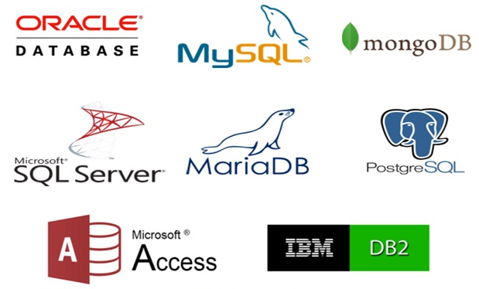
Basic Concepts
Database: is a collection of related data and data is a collection of facts and figures that can be processed to produce information.
Database Management System (DBMS): the technology of storing and retrieving data with utmost efficiency along with appropriate security measures.
DBMS Characteristics:
ACID.
Multi users and concurrent access.
Multiple views.
Security.
Notes:
DBMS Characteristics:
ACID Properties − DBMS follows the concepts of Atomicity, Consistency, Isolation, and Durability (normally shortened as ACID).
Multiuser and Concurrent Access − DBMS supports multi-user environment and allows them to access and manipulate data in parallel.
Multiple views − DBMS offers multiple views for different users. A user who is in the Sales department will have a different view of database than a person working in the Production department.
Security − Features like multiple views offer security to some extent where users are unable to access data of other users and departments. DBMS offers methods to impose constraints while entering data into the database and retrieving the same at a later stage. Since a DBMS is not saved on the disk as traditional file systems, it is very hard for miscreants to break the code.

Slide 3
Basic Concepts
The DBMS manages three important things:
The data.
The database engine that allows data to be accessed, locked and modified.
The database schema, which defines the database's logical structure.

Slide 4

Advantages of DB
Reduced data redundancy
Reduced updating errors and increased consistency
Greater data integrity and independence from applications programs
Improved data access to users through use of host and query languages
Improved data security
Reduced data entry, storage, and retrieval costs
Facilitated development of new applications program

Slide 5

Disadvantages of DB
Database systems are complex, difficult, and time-consuming to design
Substantial hardware and software start-up costs
Damage to database affects virtually all applications programs
Extensive conversion costs in moving form a file-based system to a database system
Initial training required for all programmers and users

Slide 6
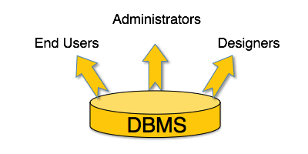
Who can use DB?
A typical DBMS has users with different rights and permissions who use it for different purposes. Some users retrieve data and some back it up.
Notes:
Administrators − are responsible for administrating the database. They are responsible to look after its usage and by whom it should be used. They create access profiles for users and apply limitations to maintain isolation and force security.
Designers − Designers are the group of people who actually work on the designing part of the database. They keep a close watch on what data should be kept and in what format. They identify and design the whole set of entities, relations, constraints, and views.
End Users − End users are those who actually reap the benefits of having a DBMS. End users can range from simple viewers who pay attention to the logs or market rates to sophisticated users such as business analysts.

Slide 7
Database Architecture
The design of a DBMS depends on its architecture. The architecture of a DBMS can be seen as either single tier or multi-tier.
An n-tier architecture divides the whole system into related but independent n modules.
In 1-tier architecture, the DBMS is the only entity where the user directly sits on the DBMS and uses it. Any changes done here will directly be done on the DBMS itself.
In 2-tier architecture, then it must have an application through which the DBMS can be accessed. Here the application tier is entirely independent of the database.

Slide 8
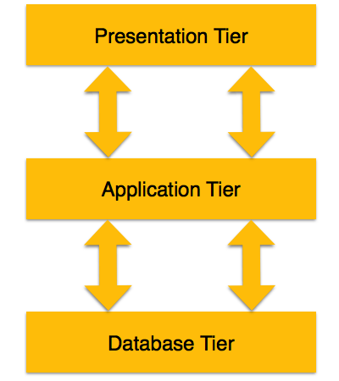
Database Architecture
A 3-tier architecture separates its tiers from each other based on the complexity of the users and how they use the data present in the database. It is the most widely used architecture to design a DBMS.
Data (Internal)
Middle (Conceptual)
Presentation (External)
Notes:
Database (Data) Tier − At this tier, the database resides along with its query processing languages. We also have the relations that define the data and their constraints at this level.
Application (Middle) Tier − At this tier reside the application server and the programs that access the database. For a user, this application tier presents an abstracted view of the database. End-users are unaware of any existence of the database beyond the application. At the other end, the database tier is not aware of any other user beyond the application tier. Hence, the application layer sits in the middle and acts as a mediator between the end-user and the database.
User (Presentation) Tier − End-users operate on this tier and they know nothing about any existence of the database beyond this layer. At this layer, multiple views of the database can be provided by the application. All views are generated by applications that reside in the application tier.

Slide 9
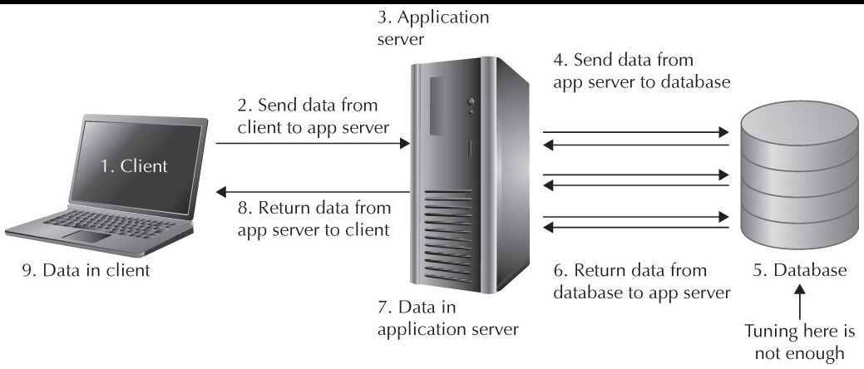
How Application Accesses DB?

Slide 10
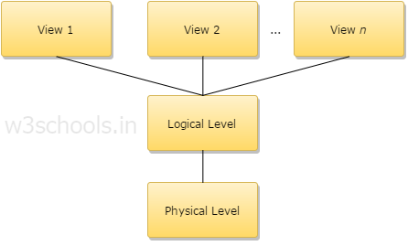
Data Independence
A database system normally contains a lot of data in addition to users’ data. For example, it stores data about data, known as metadata, to locate and retrieve data easily.
Metadata (Logical data) itself follows a layered architecture, so that when we change data at one layer, it does not affect the data at another level.
Types of Schema:
Views.
Logical.
Physical.
Notes:
A physical schema can be defined as the design of a database at its physical level. In this level, it is expressed how data is stored in blocks of storage.
A logical schema can be defined as the design of the database at its logical level. In this level, the programmers as well as the database administrator (DBA) work. At this level, data can be described as certain types of data records which can be stored in the form of data structures. However, the internal details (such as an implementation of data structure) will be remaining hidden at this level.
View schema can be defined as the design of the database at view level which generally describes end-user interaction with database systems.
EX: Let suppose, you are storing students' information on a student's table. At the physical level, these records are described as chunks of storage (in bytes, gigabytes, terabytes or higher) in memory, and these elements often remain hidden from the programmers. Then comes the logical level; here in logical level these records can be illustrated as fields and attributes along with their data type(s), their relationship with each other can be logically implemented. Programmers generally work at this level because they are aware of such things about database systems. At view level, a user can able to interact with the system, with the help of GUI and enter the details on the screen.

Slide 11

Structured Query Language
SQL is a database computer language designed for the retrieval and management of data in a relational database. SQL stands for Structured Query Language.
It is a computer language for storing, manipulating and retrieving data stored in a relational database.
SQL is the standard language for Relational Database System.
All the Relational Database Management Systems (RDMS) like MySQL, MS Access, Oracle, Sybase, Informix, Postgres and SQL Server.

Slide 12
Structured Query Language
ANSI SQL
Transact SQL [MS]
PL SQL [Oracle]
IBM PL SQL [IBM]
MYSQL [OS]
Access
MS SQL Server
SQL Azure
Notes:
ANSI: American National Standards Institute
SQL: Structured Query Language
Open MSSQLSERVER

Slide 13
T-SQL Commands
Commands
DDL
DML
DCL
DQL
TCL
Create
Alter
Drop
Insert
Update
Delete
Merge
Grant
Deny
Revoke
Select
Join
Sub-Query
Grouping
Aggregation
Union
Begin transaction
Commit
Rollback
Notes:
DDL, Constraints

Slide 14
Structured Query Language
SQL Query
Query Language Processor
DBMS Engine
Physical Database
Parser and Optimizer
File Manager and
Transaction Manager

Slide 15
Thanks
Notes:
Resources:
Constraints: https://www.w3schools.com/sql/sql_constraints.asp
Data Types: https://www.w3schools.com/sql/sql_datatypes.asp
Delete vs. Truncate: https://www.javatpoint.com/delete-vs-truncate-command
Installing SQL: https://www.sqlshack.com/step-by-step-installation-of-sql-server-2017/ - https://www.youtube.com/watch?v=yasfZuou3zI

